Slide 1

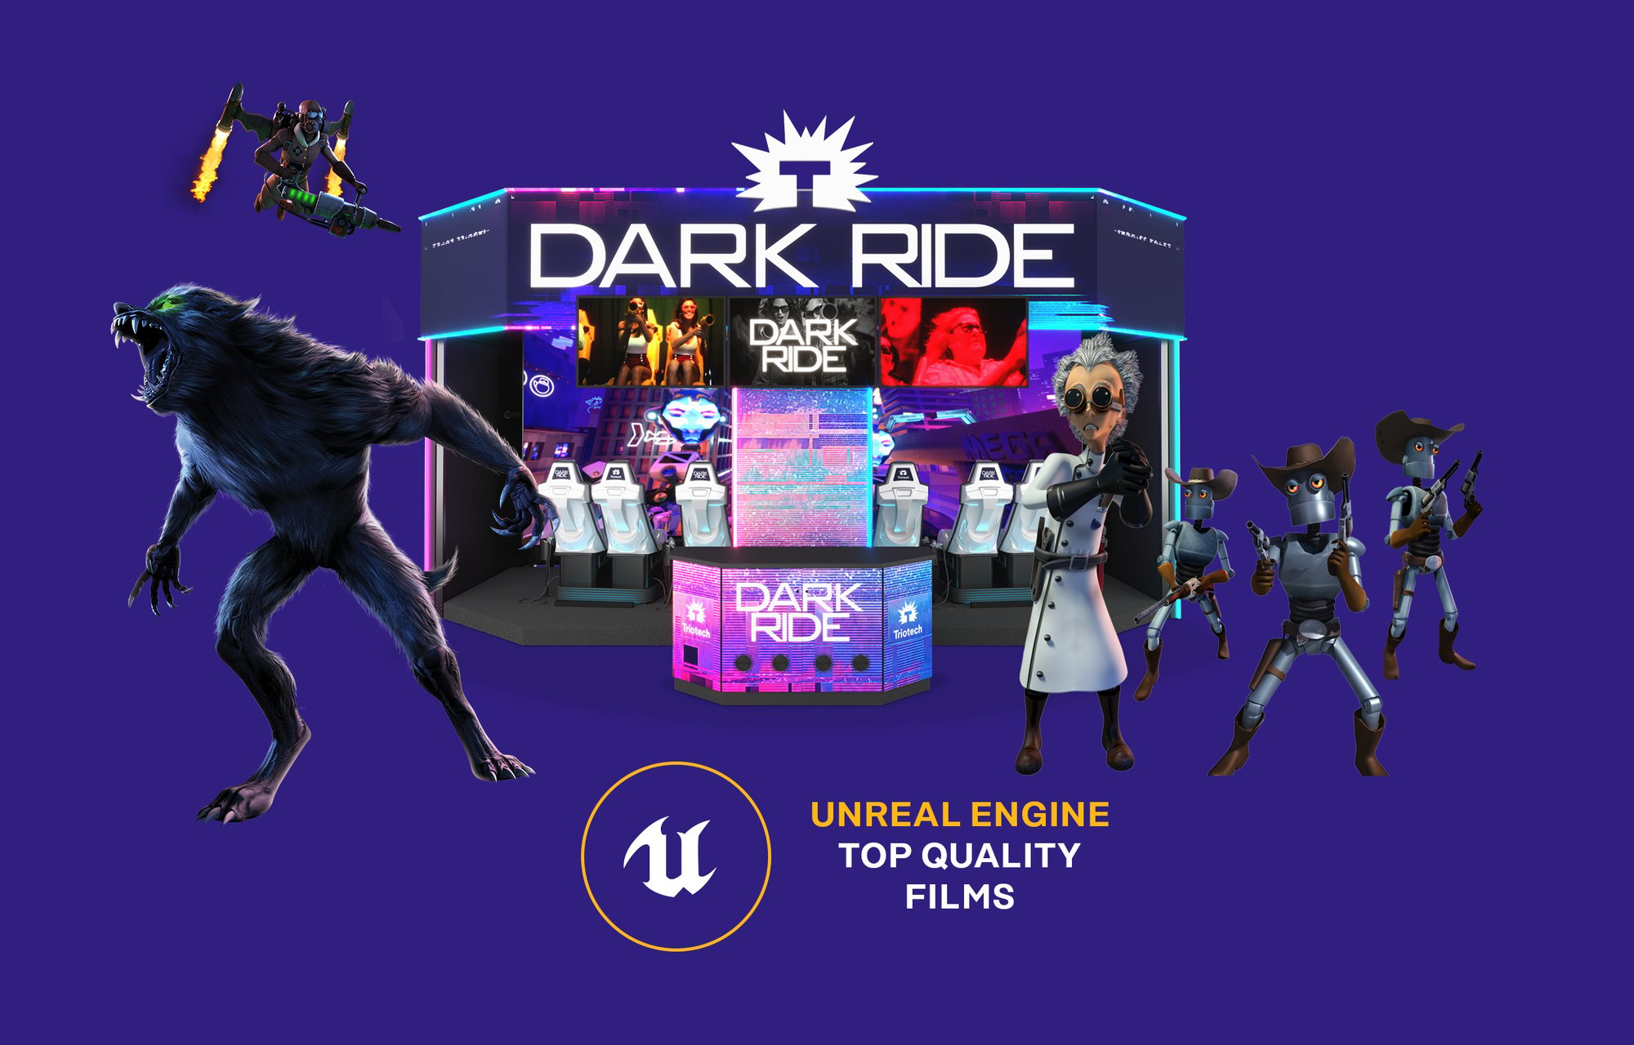
TRIOTECH XD DARK RIDE · PLATFORM PROPOSAL
The operator platform
for XD Dark Ride
A Playbox platform proposal for
Triotech’s existing attraction
Prepared for a partnership discussion
Product visual: Triotech
Notes:
Proposed digital platform for the existing Triotech XD Dark Ride. Official product visual and unaltered logo sourced from https://go.trio-tech.com/contact-xd-dark-ride . This is not an announced service. Product source: https://www.trio-tech.com/products/xd-dark-ride/ .

Slide 2
The partnership proposition
A customer and service platform for Triotech’s existing XD Dark Ride.
For attraction owners
For Triotech
Understand title usage and actual sales.
Purchase approved game licenses.
Get service help with machine evidence attached.
Give customers a consistent digital experience.
Connect content commerce to installed hardware.
Measure whether guided support reduces technician effort.
Proposed value, subject to operator interviews and a measured pilot.
02
Notes:
Original partnership recommendation. No measured savings or existing commercial relationship claimed.

Slide 3
Built specifically for XD Dark Ride
The existing attraction defines the platform’s data and service model.
Published product feature | Platform requirement
Multi-seat interactive theater | Track cycles and occupied seats separately
Individual scoring | Expose score statistics only through a supported interface
Renewable content library | Connect licensing, compatibility and title usage
Site-specific installation | Register actual hardware and software capabilities
XD Dark Ride only. XD Theater, QUBE and SuperBlaster are outside the proposed release.
03
Notes:
Product source: https://www.trio-tech.com/products/xd-dark-ride/ . Platform requirements are proposed. Public descriptions do not establish telemetry or remote-command APIs.

Slide 4
Playbox already has the platform foundation
Read-only source inspection confirms implemented capabilities to adapt.
Existing Playbox source | Triotech work to validate
Customer and location access Analytics dashboards and event ingestion | XD Dark Ride operator roles and session definitions
Stripe checkout and game entitlements Device assignment and compatible builds | Commercial rights, DRM and hardware compatibility
MCP tools and signed support jobs Expiry, run limits and gameplay guard | Approved diagnostic procedures and machine-state checks
Source inspection establishes implementation, not production readiness or Triotech compatibility.
04
Notes:
Internal evidence: D:/PlayboxWorkspace/PlayboxAnalyticsApi/src/access.ts:143; routes/analytics.ts:111; routes/store.ts:1580; gameCommerce.ts:15; gameDistribution.ts:176; mcpServer.ts:55; supportAutomationExecution.ts:12; routes/supportAutomation.ts:149. No live verification or test execution. Detailed evidence matrix in research-and-plan.html.

Slide 5
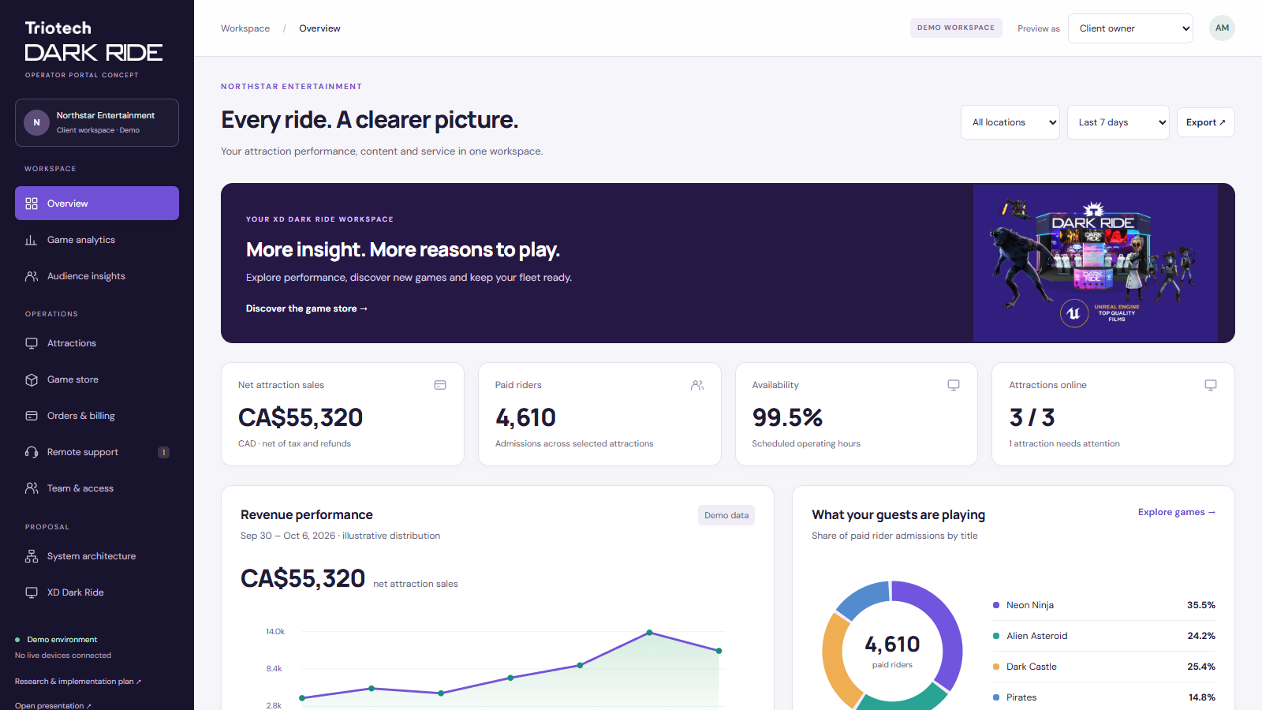
The owner’s view
A single place to understand the fleet.
Location and period filters
Attraction health and drill-down
Sales that reconcile to a source
Interactive prototype · synthetic data · CAD
05
Notes:
Original UI mockup. All companies, metrics, status and transactions are illustrative. Net sales require a POS/cashless source that has not yet been connected. Existing Playbox gameplay ingest is not an attraction-revenue feed.

Slide 6
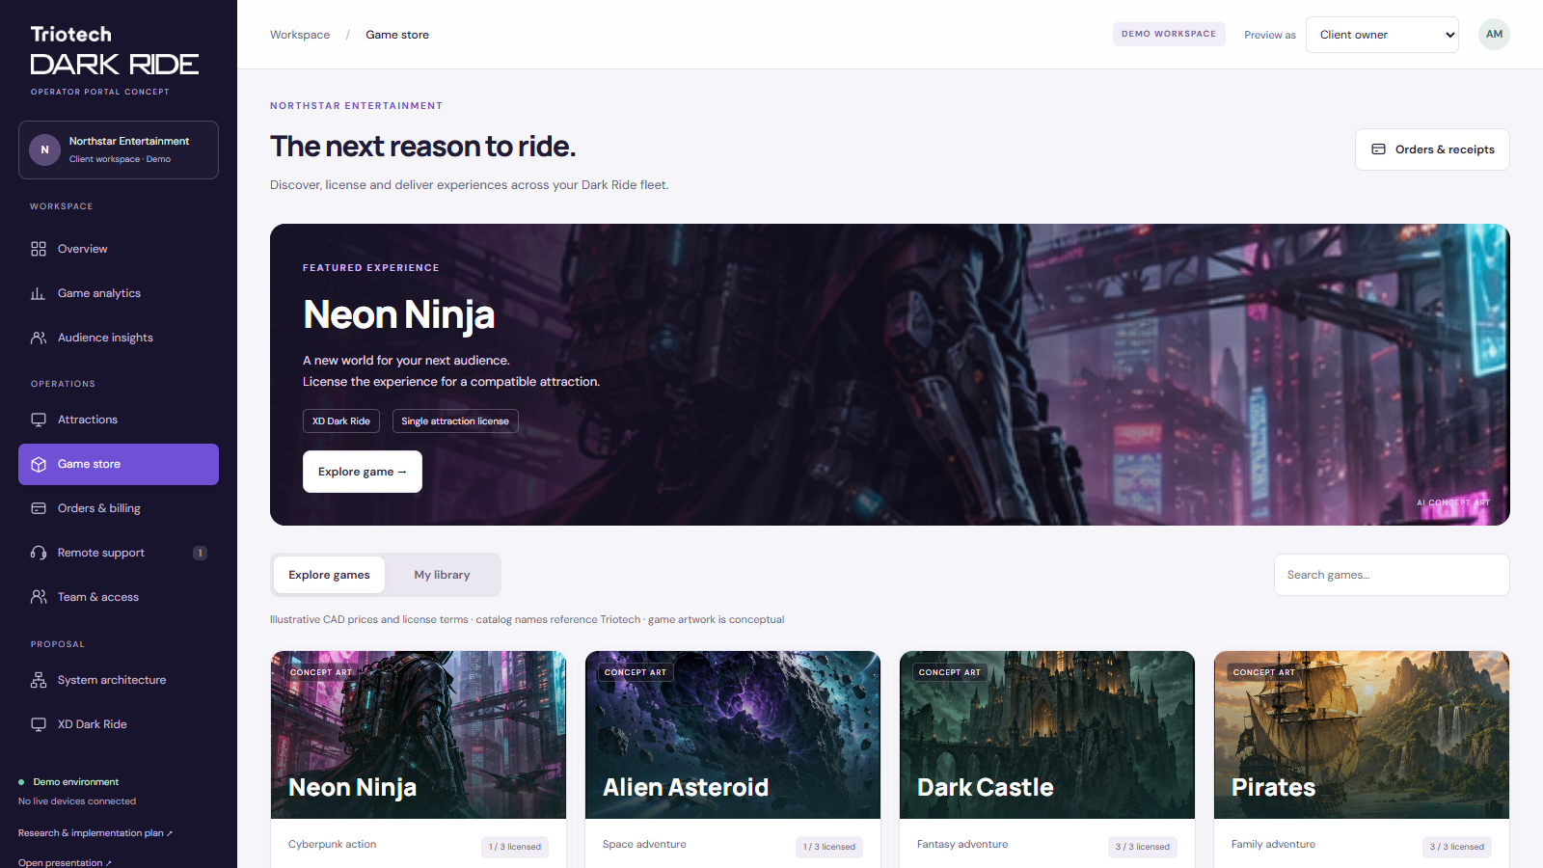
A game store with a purchase workflow
Illustrated titles, attraction assignment and a clear route to checkout.
Explore the game catalog
Select an attraction license
Track delivery separately
Example CAD prices and annual terms. Availability and rights require Triotech approval.
06
Notes:
Store mockup uses synthetic prices and annual license terms, not actual Triotech offers. Game title names reference https://www.trio-tech.com/products/xd-dark-ride/ . Game art is AI concept artwork. No real purchase or Stripe connection exists in this prototype.

Slide 7
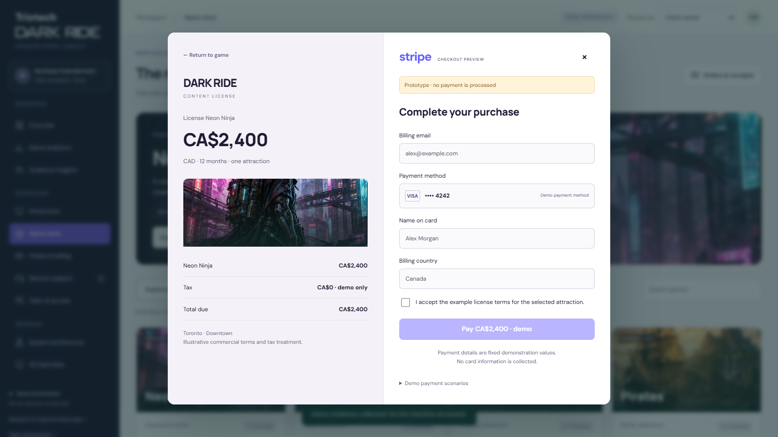
Stripe checkout and license fulfillment
Payment confirmation creates an entitlement for the selected attraction.
Hosted payment experience
Verified fulfillment event
Receipt and install schedule
Local checkout simulation. No cards charged or real Stripe account connected.
07
Notes:
Recommended production pattern: server-created Checkout Session, verified webhook and idempotent fulfillment. Source: https://docs.stripe.com/checkout/fulfillment.md?payment-ui=stripe-hosted and https://docs.stripe.com/webhooks . Demo prices and terms are synthetic. Pending and declined payments grant no license.

Slide 8
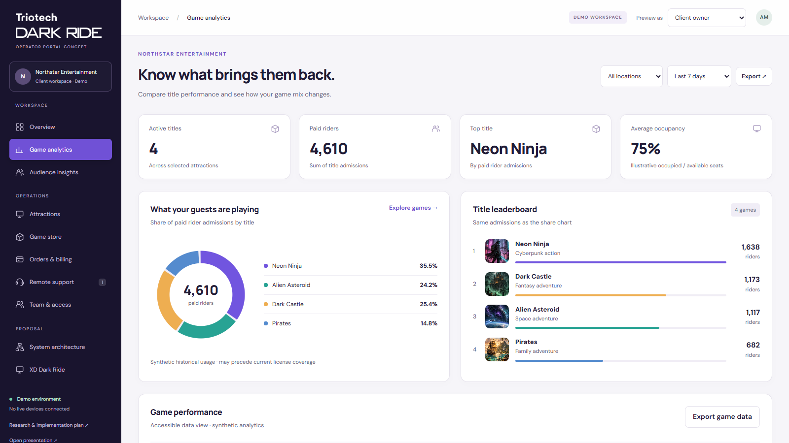
Game performance and title mix
Visual comparisons with a consistent admissions denominator.
Donut chart for title share
Illustrated title leaderboard
Location and period filters
Synthetic historical activity. Game-level sales use an illustrative allocation.
08
Notes:
Original mockup with synthetic data. Donut percentages derive from the same counts used in the leaderboard. Current entitlement coverage may differ from historical title usage. No real telemetry or POS feed connected.

Slide 9
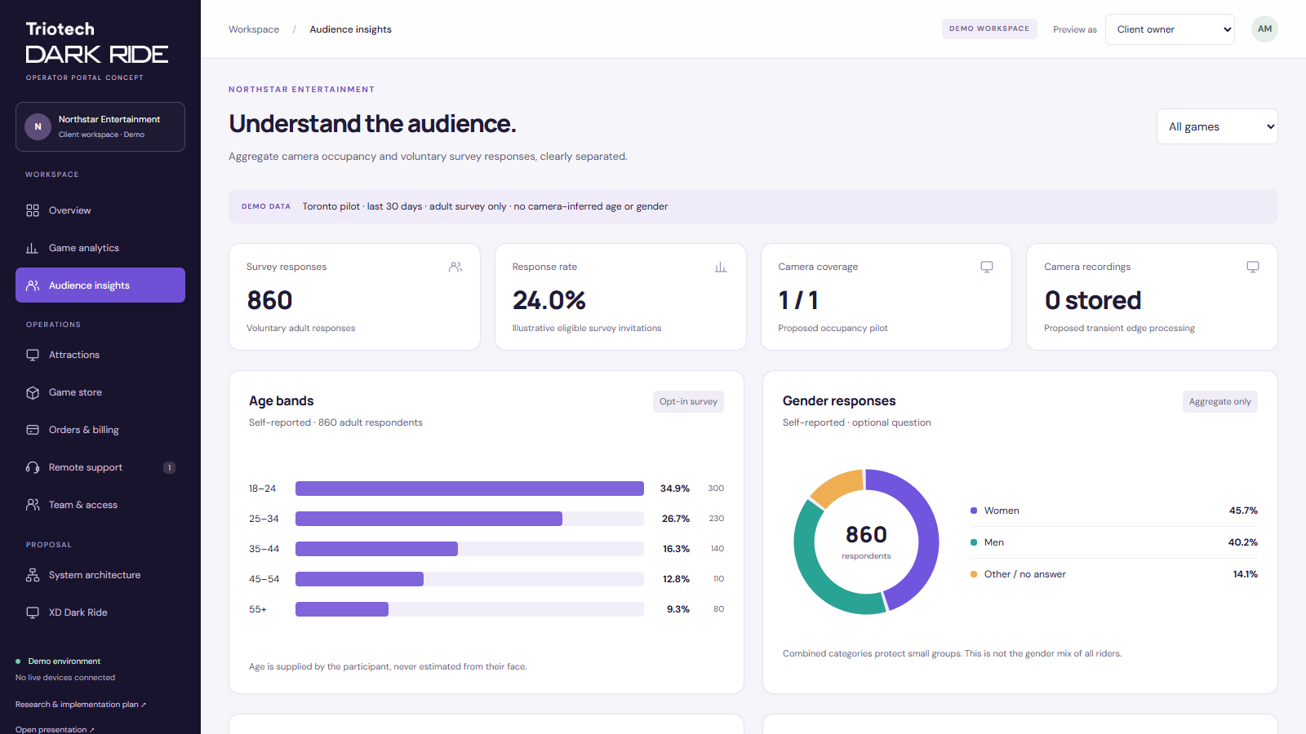
Audience insights with clear data sources
Camera occupancy and voluntary demographic responses serve separate purposes.
Occupancy counts on device
Optional adult demographic survey
Aggregate reports with sample size
No sex or gender inference from images. Camera capability requires vendor validation.
09
Notes:
Original proposed design. The user reports that the attraction has a camera; stream access and usable coverage are not verified. Camera processing provides occupancy only, with no stored frames in the proposed pipeline. Demographic age bands and gender are voluntarily self-reported by adults. Dataset is synthetic, with suppression and sampling requirements detailed in architecture.html.

Slide 10
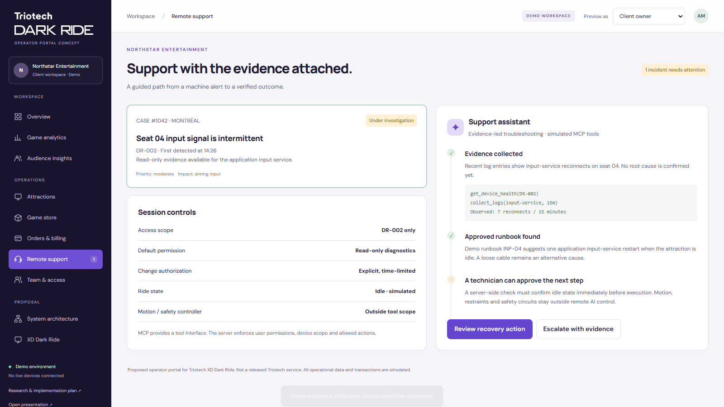
Support starts with evidence
A guided investigation that leaves an audit trail.
Read bounded diagnostic data
Use an approved runbook
Verify or escalate the outcome
Simulated incident and recovery flow · no live machine connection
10
Notes:
Original support UX. MCP design reference: https://modelcontextprotocol.io/docs/2026-07-28/tutorials/security/security_best_practices . Actual Triotech logs, tools and runbooks are not available. The example application restart is conceptual and requires vendor approval.

Slide 11
Access follows customer and site boundaries
Each role receives only its assigned data and actions.
Role | Primary scope | Boundary
Client owner | Owned sites and commercial decisions | No access to other clients
Site operator | Assigned site and daily checks | Separate purchase and finance permissions
Support specialist | Assigned cases and approved tools | Time-limited device scope
Triotech administrator | Customers, catalog and policies | Audited elevation for customer support
The prototype role switch previews behavior. Production APIs must enforce every boundary.
11
Notes:
Original proposed role model, informed by Playbox access.ts. Requires implementation and negative authorization testing for the Triotech deployment.

Slide 12
Trustworthy metrics need clear definitions
Ride activity and financial results come from different sources.
Attraction telemetry
Sales and availability
Sessions and paid riders are different counts.
Track occupied seats, title versions and aborted cycles.
Show unknown or stale data explicitly.
Net sales come from POS or cashless reconciliation.
Revenue estimates must say they are estimates.
A heartbeat does not establish ride readiness.
Metrics must match the supported XD Dark Ride interface and the operator’s accounting source.
12
Notes:
Original data recommendations. Playbox ingest contract source: PlayboxAnalyticsUploader/src/PlayboxAnalyticsUploader/Ingest/IngestContracts.cs:15–28. Existing fields contain gameplay data, not ticket sales, tax or refunds. AGENTS.md warns that online/heartbeat status does not establish rollout readiness.

Slide 13
Integration architecture
A dedicated XD Dark Ride adapter connects the attraction to reusable Playbox services.
Layer | Responsibility | Control
Machine agent | Vendor adapters, offline queue and signed content | Outbound identity and fresh local checks
Platform services | Tenant data, reports, cases and entitlements | Server-side access checks and audit
MCP support broker | Bounded diagnostics and runbook actions | Independent policy and fresh state checks
Content delivery | Signed package and staged activation | Compatibility, idle window and rollback
Local ride-control and safety systems remain authoritative.
13
Notes:
Proposed architecture. Existing Playbox cloud topology is documented in Docs/PlayboxAnalyticsSystemDesign.md:16–32 but was not verified live. MCP reference: https://modelcontextprotocol.io/docs/2026-07-28/tutorials/security/security_best_practices .

Slide 14
Automation has a defined operating boundary
The model proposes actions. The service layer decides what is permitted.
Observe | Controlled repair | Escalate locally
Read health and versions | Vendor-approved software action | Motion or restraint fault
Collect redacted logs | Explicit device-scoped approval | Emergency-stop condition
Cite an approved runbook | Fresh idle-state check | Unknown controller state
Prepare a service packet | One attempt and outcome verification | Calibration or physical repair
Start the pilot with read-only diagnostics. Add repair actions only after joint validation.
14
Notes:
Original proposed safety/authority boundary, not a claim of certification. Existing Playbox source has signed exact scripts and bounded authorizations. Triotech-specific controls must be designed with its engineering/service teams. MCP security best practices source in source register.

Slide 15
A staged joint pilot
An 18-week planning sequence, dependent on hardware access and licensing.
Window | Work | Decision gate
Weeks 1–2 | Joint discovery and baseline | Supported interfaces and rights confirmed
Weeks 3–6 | Lab adapter and data proof | Reconciliation and tenant isolation pass
Weeks 7–10 | Portal and diagnostic workflows | Evidence and runbook tests pass
Weeks 11–14 | Content rehearsal and field pilot | 3–5 installations, at least 2 operators
Weeks 15–18 | Observation and hardening | Measured value and rollout decision
Timing is an assumption. Extend observation if the incident sample is too small.
15
Notes:
Original proposed roadmap. Not a vendor commitment or fixed delivery estimate. Full dependencies, owners and scope appear in the research brief.

Slide 16
Pilot success is measurable
Agree definitions and baselines before comparing outcomes.
Area | Proposed acceptance measure
Data quality | ≥99% eligible event capture within the agreed window
Financial reporting | Daily reconciliation to the authoritative sales source
Support effort | Test a ≥20% reduction in median handling minutes for eligible cases
Permissions and recovery | No unauthorized action in the agreed test scenarios
Usability | At least 4 of 5 users complete the core tasks unaided
These are proposed targets, not existing performance or savings claims.
16
Notes:
Original acceptance proposals. Report incident count, mix, uncertainty, reopen rate and escalations. Small pilot results do not establish rare-event reliability or fleet-wide ROI.

Slide 17
Commercial responsibilities
The agreement should separate platform delivery from content and ride authority.
Triotech leads
Playbox partner leads
Hardware interfaces and approved service procedures.
Content catalog, rights and commercial terms.
Pilot installations and service-team validation.
Portal, telemetry services and integration delivery.
Customer access and support orchestration.
Platform operations under an agreed service model.
Discuss paid discovery, milestone-funded pilot and a later OEM platform license.
17
Notes:
Proposed allocation only. Negotiate data ownership, hosting, support hours, incident responsibilities, reusable IP, pricing, content transaction fees and exit arrangements. No actual agreement is represented.

Slide 18
The next step is a joint discovery
A small commitment that resolves the largest unknowns.
01
An engineering sponsor and a service sponsor
02
One representative XD Dark Ride and approved interface access
03
A current-tooling walkthrough and redacted support examples
04
Two candidate operators and an agreed pilot scorecard
Requested decision: scope a paid discovery and identify the people who can validate it.
18
Notes:
Proposed meeting ask. No messages or requests have been sent to Triotech. Live demo: outputs/index.html. Detailed research and scope: outputs/research-and-plan.html.

Slide 19
Research and evidence
First-party sources and authorized local source inspection, checked 6 October 2026.
Triotech product context
XD Dark Ride product specifications and catalog
Official Dark Ride branding and product visuals
Granby Zoo installation and Jumanji content partnership
Market and technical benchmarks
Embed STATS, REPORTS and Central Games Management
Semnox Parafait Analytics
Model Context Protocol security best practices
Playbox implementation evidence
Analytics API, dashboard, uploader and support code
Source review only. No production-readiness claim.
Full links, caveats and file-level references are in the accompanying research brief.
19
Notes:
https://www.trio-tech.com/products/xd-dark-ride/ ; https://www.trio-tech.com/products/xd-theater/ ; https://www.trio-tech.com/news/triotech-launches-revolutionary-multiplayer-coin-op-attraction/ ; https://www.trio-tech.com/products/superblaster-coinop-arcade-game/ ; https://www.trio-tech.com/news/triotech-jumanji-xd-dark-ride-sony-merlin/ ; https://www.embedcard.com/en/software-solutions/stats ; https://www.embedcard.com/software-solutions/reports ; https://www.embedcard.com/software-solutions/cgm ; https://www.semnox.com/parafait-analytics-mobile-app/ ; https://modelcontextprotocol.io/docs/2026-07-28/tutorials/security/security_best_practices . Local roots D:/PlayboxWorkspace/PlayboxAnalyticsApi, PlayboxAnalyticsDashboard, PlayboxAnalyticsUploader and Docs. Official visual source: https://go.trio-tech.com/contact-xd-dark-ride . XD Dark Ride case study: https://trio-tech.com/news/triotech-sets-up-first-interactive-interactive-theatre-xd-dark-ride-in-granby-zoo/ .

Slide 20
Internal planning envelope
Appendix for leadership. Remove or revise before external commercial discussions.
CA$240k–470k
Discovery through pilot hardening, including 20% contingency.
2,000–2,800 assumed hours
CA$100–140 assumed blended hourly rate
Discovery tranche: 120–200 hours
CA$12k–28k, included in the total
Illustrative estimate, not a quote. Excludes hardware, travel, content rights, fees, tax and ongoing operations.
20
Notes:
Original internal planning assumptions. Calculation: 2,000 × 100 × 1.2 = 240,000; 2,800 × 140 × 1.2 = 470,400. Discovery: 120 × 100 = 12,000 to 200 × 140 = 28,000, included in total. Re-estimate after supported-interface and Playbox reuse reviews.

Slide 21
Support savings require a baseline
Internal illustration for 50 attractions. These are invented scenario inputs.
Monthly labor-capacity model | Conservative | Base | Higher benefit
Tickets per device | 2 | 3 | 4
Eligible × resolved share | 40% × 30% | 60% × 50% | 70% × 60%
Minutes saved / hourly cost | 20 / CA$60 | 25 / CA$70 | 30 / CA$80
Gross capacity value | CA$240 | CA$1,312.50 | CA$3,360
Net after CA$1,200 operating assumption | −CA$960 | CA$112.50 | CA$2,160
Before build cost. Capacity value is not necessarily cash savings. No downtime or content uplift included.
21
Notes:
Original illustrative model: devices × tickets/device × eligible share × resolution share × minutes/60 × labor rate. Net subtracts an assumed CA$1,200 monthly incremental operations cost. No forecast, ROI promise or vendor price. Base support-only scenario does not justify a large build by itself.

